Slide 1
Chapter 8: Memory Management

Slide 2
Background
To run a process, it must be brought (from disk) into the main memory
Main memory and registers are only storage CPU can access directly
Register access in one CPU clock (or less)
Cache sits between main memory and CPU registers
Protection of memory required to ensure correct operation

Slide 3
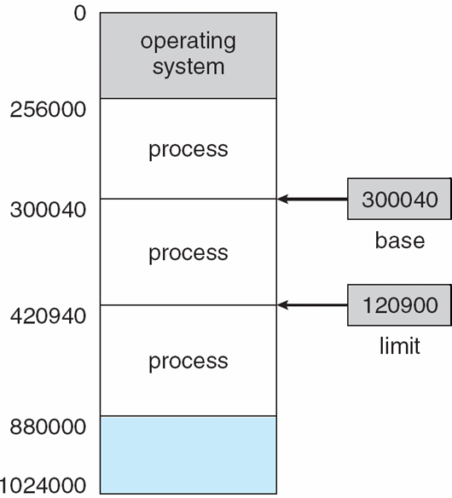
Base and Limit Registers
A pair of base and limit registers define the logical address space
The base register holds smallest legal physical address
The limit register specifies the size of the range
CPU must check every memory access generated in user mode to be sure it is between base and limit for that user

Slide 4
Hardware Address Protection with Base and Limit Registers

Slide 5
Address Binding
Programs reside on disk, ready to be brought into memory to execute from an input queue
Without support, must be loaded into address 0000
Addresses represented in different ways at different stages of a program’s life
Source code addresses are usually symbolic
Compiler binds symbolic addresses to re-locatable addresses
i.e. “14 bytes from beginning of this module”
Linker or loader will bind re-locatable addresses to absolute addresses
i.e. 74014
Each binding maps one address space to another

Slide 6
Binding of Instructions and Data to Memory
Address binding of instructions and data to memory addresses can happen at three different stages
Compile time: If memory location known a prior, then absolute code can be generated; must recompile code if starting location changes
Load time: Must generate re-locatable code if memory location is not known at compile time
Execution time: Binding delayed until run time if the process can be moved during its execution from one memory segment to another
Need hardware support for address maps (e.g., base & limit registers)

Slide 7
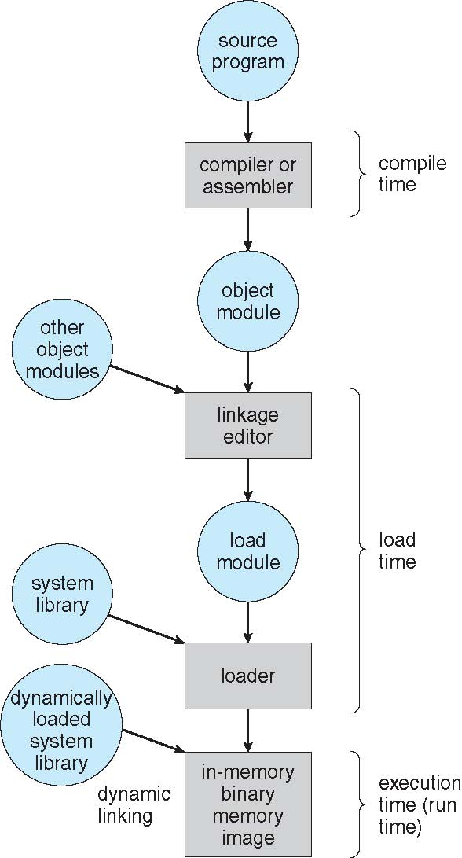
Multistep Processing of a User Program
Figure 8.3 Multistep processing of a user program.

Slide 8
Overlays
For execution, the executable code must be present in the main memory.
What if the size of code and data exceeds the size of main memory ?
Overlays
Partition the program into mutually exclusive partitions
Load the first partition
After its execution, replace it with the next partition
As the code and data of the first is no longer needed.

Slide 9
Logical vs. Physical Address Space
The concept of a logical address space that is bound to a separate physical address space is central to proper memory management
Logical address – generated by the CPU; also referred to as virtual address
Physical address – address seen by the memory unit
Logical and physical addresses are the same in compile-time and load-time address-binding schemes; logical (virtual) and physical addresses differ in execution-time address-binding scheme
Logical address space is the set of all logical addresses generated by a program
Physical address space is the set of all physical addresses corresponding to the set of logical addresses

Slide 10
Memory-Management Unit (MMU)
Hardware device that maps virtual to physical address at run time
Many methods possible
To start, consider simple scheme where the value in the relocation register is added to every address generated by a user process at the time it is sent to memory
Base register now called relocation register
The user program deals with logical addresses; it never sees the real physical addresses
Execution-time binding occurs when reference is made to location in memory
Logical address bound to physical addresses

Slide 11
Dynamic relocation using a relocation register
Routine is not loaded until it is called
Better memory-space utilization; unused routine is never loaded
All routines kept on disk in relocatable load format
Useful when large amounts of code are needed to handle infrequently occurring cases
No special support from the operating system is required
Implemented through program design
OS can help by providing libraries to implement dynamic loading

Slide 12
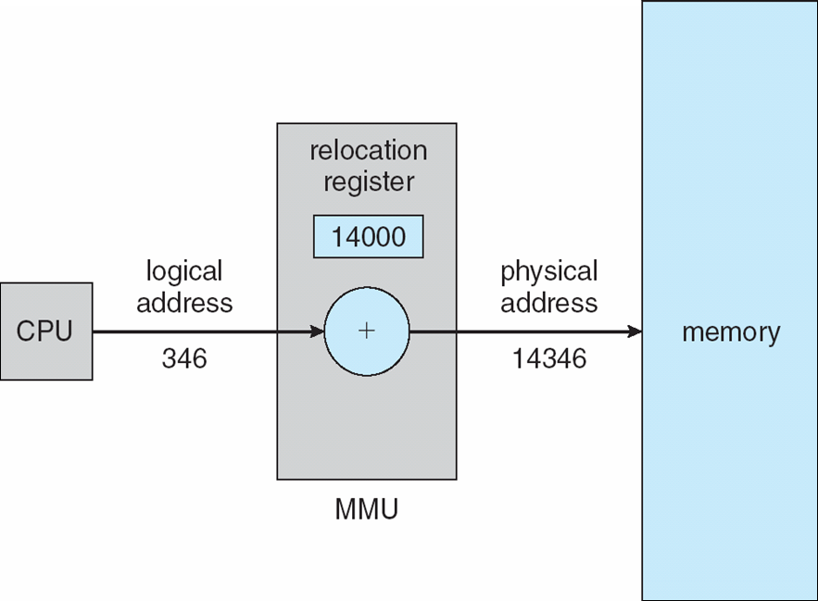
Example
If there are five users working on a system.
Each of the user processes have logical address space starting at zero.
However, each will be mapped to different physical address in the main memory.
So if user A has a logical space from 0 – 150
It’s physical address space can be from 2000 – 2150
And if user B has a logical space from 0 – 150
It’s physical address space can be from 4000 – 4150
Figure 8.4 Dynamic relocation using a relocation register.

Slide 13
Dynamic Linking
Static linking – System libraries are treated like any other object module and are combined by the loader into the binary program image
Dynamic linking –linking postponed until execution time
Without this facility, all programs on a system need to have a copy of their language library included in the executable image
This requirement wastes both disk space and main memory
With dynamic linking a small piece of code, stub, used to locate the appropriate memory-resident library routine
Stub replaces itself with the address of the routine, and executes the routine
Operating system checks if routine is in processes’ memory address
If not in address space, add to address space
Dynamic linking is particularly useful for libraries
Consider applicability to patching system libraries
Versioning may be needed

Slide 14
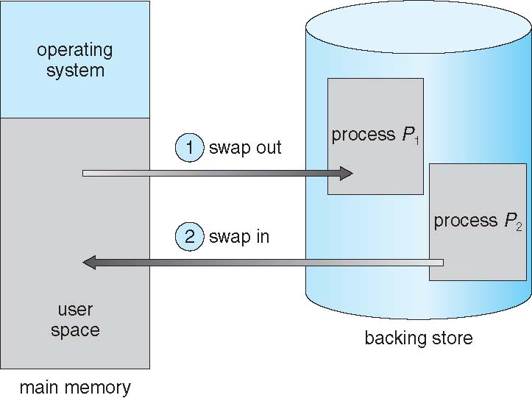
Swapping
A process can be swapped temporarily out of memory to a backing store, and then brought back into memory for continued execution
Total physical memory space of processes can exceed physical memory
Backing store – Fast disk large enough to accommodate copies of all memory images for all users; must provide direct access to these memory images
Roll out, roll in – Swapping variant used for priority-based scheduling algorithms; lower-priority process is swapped out so higher-priority process can be loaded and executed
Major part of swap time is transfer time; total transfer time is directly proportional to the amount of memory swapped
System maintains a ready queue of ready-to-run processes which have memory images on disk

Slide 15
Swapping (Cont.)
Does the swapped-out process need to swap back into same physical addresses?
Depends on address binding method
Plus consider pending I/O to/from process memory space
Modified versions of swapping are found on many systems (i.e., UNIX, Linux, and Windows)
Swapping normally disabled
Started if more than threshold amount of memory allocated
Disabled again once memory demand reduced below threshold

Slide 16
Context Switch Time including Swapping
If next processes to be put on CPU is not in memory, need to swap out a process and swap in target process
Context switch time in such system can be very high
100 MB process swapping to backing store (i.e., standard hard disk) with transfer rate of 50 MB/sec
100/50 = 2 sec
Assuming an average latency of 8 millisecond, the swap time is 2008 milliseconds
The total swap time for swap in and swap out is 2016 milliseconds

Slide 17
Context Switch Time and Swapping (Cont.)
Other constraints as well on swapping
Pending I/O – can’t swap out as I/O would occur to wrong process
Or always transfer I/O to kernel space, then to I/O device
Known as double buffering, adds overhead
Standard swapping not used in modern operating systems
But modified version common
Swap only when free memory extremely low

Slide 18
Contiguous Allocation
Main memory must support both OS and user processes
Limited resource, must allocate efficiently
Contiguous allocation is one early method
Main memory is usually divided into two partitions:
Resident operating system
User processes
Each process contained in single contiguous section of memory
Relocation registers used to protect user processes from each other, and from changing operating-system code and data
Base register contains value of smallest physical address
Limit register contains range of logical addresses – each logical address must be less than the limit register

Slide 19
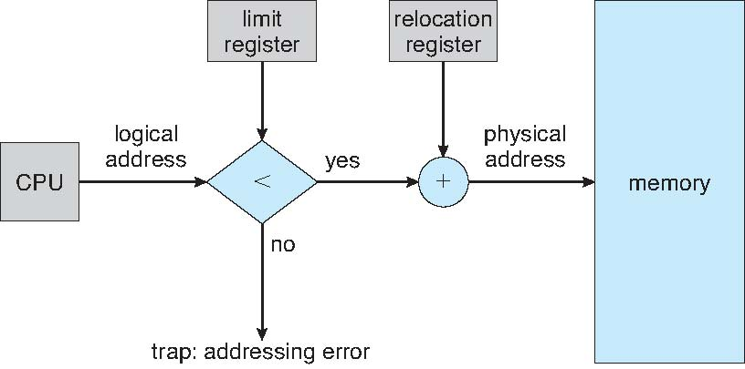
Contiguous Allocation (Cont.)
Hardware Support for Relocation and Limit Registers

Slide 20
Memory Allocation
Multiple-partition allocation
Degree of multiprogramming limited by number of partitions
Hole – block of available memory; holes of various size are scattered throughout memory
When a process arrives, it is allocated memory from a hole large enough to accommodate it
Process exiting frees its partition, adjacent free partitions combined
Operating system maintains information about
a) allocated partitions
b) free partitions (hole)

Slide 21
Memory Allocation (Cont.)
OS
OS
OS
OS
process 5
process 5
process 5
process 5
process 9
process 9
process 8
process 10
process 2
process 2
process 2
process 2
Operating system occupies a fixed amount of memory.
The rest is free for the processes to use.
Fixed memory partition
Dynamic partition

Slide 22
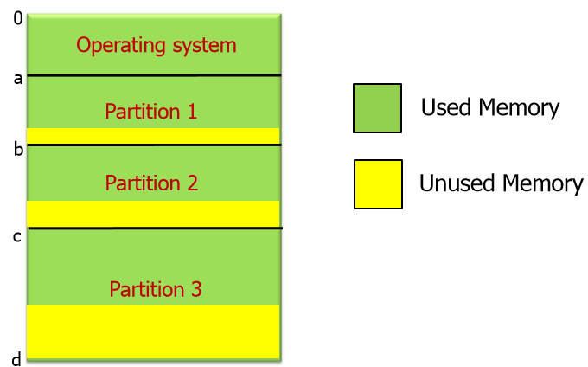
Fixed partitioning
A 32 MB RAM can be partitioned into eight equal size partitions each of 4 MB.
Since the number of partitions are fixed, the number of processes that can be run in the system is limited.
Two difficulties
Program size is larger than the partition size
Programmers need to write code using overlays
Program size is too small than the partition size
Memory wastage
What if the program size is 100 KB.
Internal fragmentation.

Slide 23
Dynamic Partitioning
As fixed partitioning leads to
Internal fragmentation
Need for overlays
To avoid the disadvantages of fixed partitioning and
To utilize the memory in more efficient way
Dynamic partitioning
Variable size and number

Slide 24
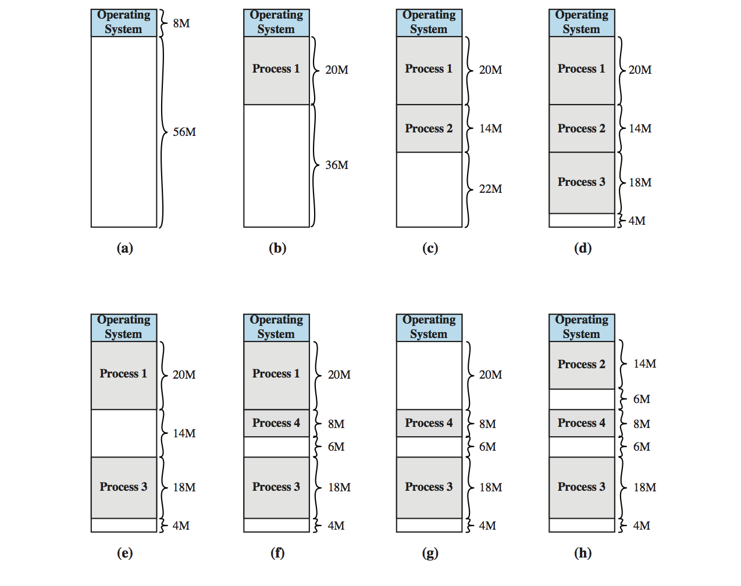
Dynamic Storage-Allocation Problem
What if we encounter a process requiring 4 Mb?

Slide 25
Dynamic Storage-Allocation Problem
First-fit: Allocate the first hole that is big enough

Slide 26
Dynamic Storage-Allocation Problem
Best-fit: Allocate the smallest hole that is big enough; must search entire list, unless ordered by size (produces the smallest leftover hole)

Slide 27
Dynamic Storage-Allocation Problem
Next-fit: Allocate the next hole from the last allocated block

Slide 28

Example
Given memory holes (i.e., unused memory blocks) of 100K, 500K, 200K, 300K and 600K (in address order) as shown below, how would each of the first-fit, next-fit, best-fit and worst-fit algorithms allocate memory requests for 290K, 420K, 110K and 350K (in this order)? The shaded areas are used/allocated regions and are not available.

Slide 29
Fragmentation
External Fragmentation – total memory space exists to satisfy a request, but it is not contiguous.
Internal Fragmentation – Allocated memory may be slightly larger than requested memory; this size difference is memory internal to a partition, but not being used.
Reduce external fragmentation by compaction
Shuffle memory contents to place all free memory together in one large block
Compaction is possible only if relocation is dynamic, and is done at execution time

Slide 30
Segmentation
Memory-management scheme that supports user view of memory
A program is a collection of segments
A segment is a logical unit such as:
main program
procedure
function
method
object
local variables, global variables
common block
stack
symbol table
arrays

Slide 31
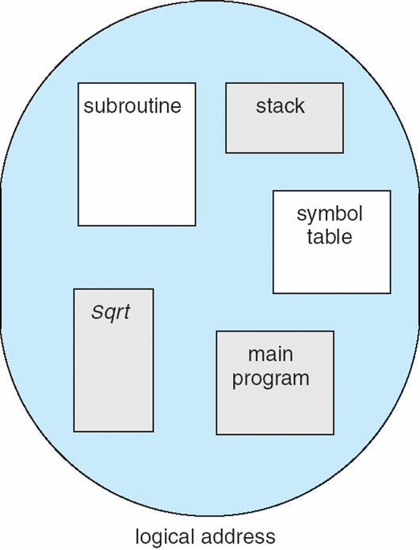
User’s View of a Program

Slide 32
Logical View of Segmentation
1
1
4
2
3
4
2
3
user space
physical memory space

Slide 33
Segmentation Architecture
Logical address consists of a two tuple:
<segment-number, offset>,
Segment table – maps two-dimensional physical addresses; each table entry has:
base – contains the starting physical address where the segments reside in memory
limit – specifies the length of the segment
Segment-table base register (STBR) points to the segment table’s location in memory
Segment-table length register (STLR) indicates number of segments used by a program;
segment number s is legal if s < STLR

Slide 34
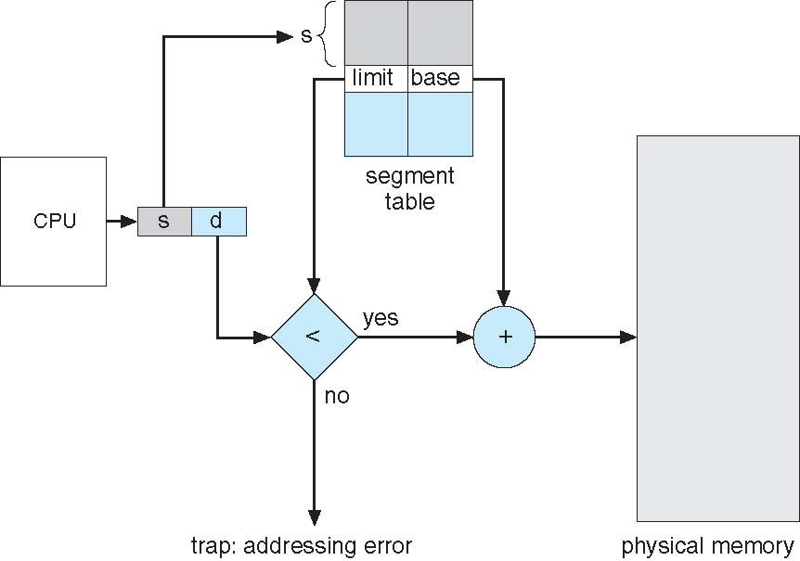
Segmentation Hardware

Slide 35
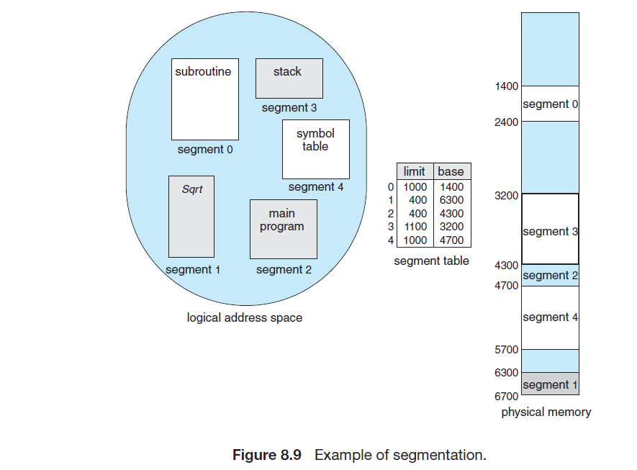
Segmentation Example

Slide 36
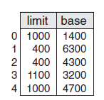
Example
Consider the following segment table:
What are the physical addresses for the following logical addresses?
0, 1222
2, 53
3, 852

Slide 37
Paging
Paging is a memory-management scheme that permits the physical-address space of a process to be noncontiguous
Avoids external fragmentation
Avoids problem of varying sized memory chunks
Divide physical memory into fixed-sized blocks called frames
Size is power of 2, between 512 bytes and 16 Mbytes
Divide logical memory into blocks of same size called pages
Keep track of all free frames
To run a program of size N pages, need to find N free frames and load program
Set up a page table to translate logical to physical addresses
Backing store likewise split into pages
Still have Internal fragmentation

Slide 38
Address Translation Scheme
Address generated by CPU is divided into:
Page number (p) – used as an index into a page table which contains base address of each page in physical memory
Page offset (d) – combined with base address to define the physical memory address that is sent to the memory unit
For given logical address space 2^{m} and page size 2 ^{n}
page number
page offset
p
d
m - n
n

Slide 39
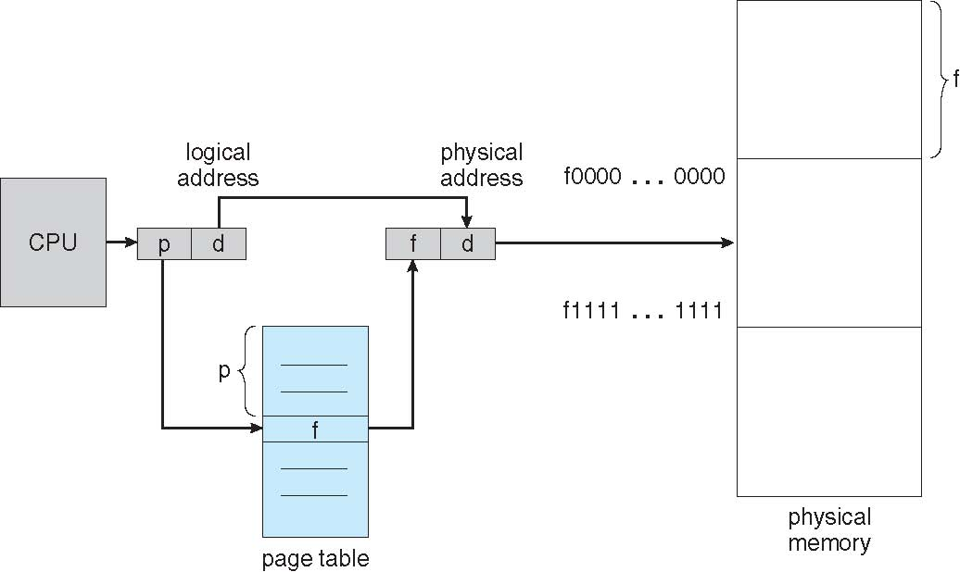
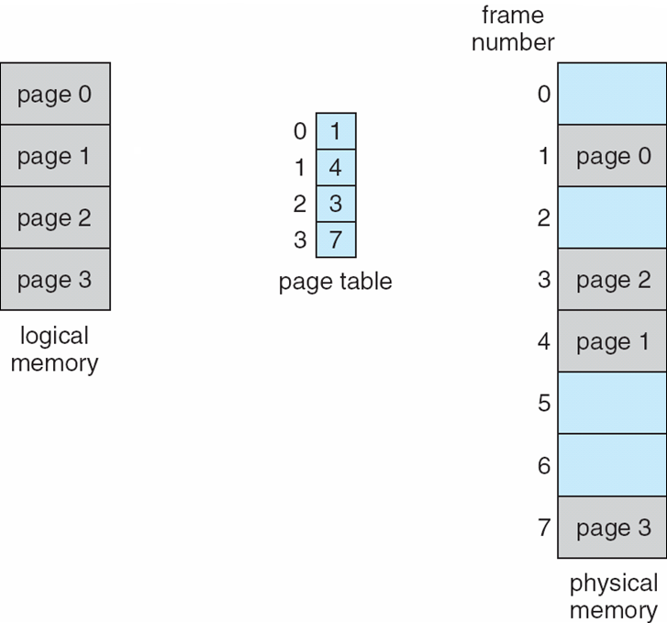
Address Translation Scheme

Slide 40
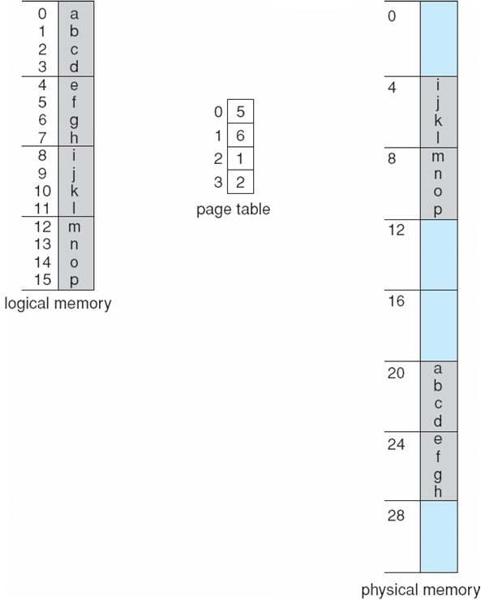
Paging Example
Logical address 0
Page 0, offset 0
Page 0 = frame 5 (5 x 4)
20 + 0 =20
Logical address 3
Page 0, offset 3
Page 0 = frame 5 (5 x 4)
20 + 3=23
Logical address 4
Page 1, offset 0
Page 1 = frame 6 (6 x 4)
24 + 0=24
n=2 and m=4 32-byte memory and 4-byte pages

Slide 41
Internal Fragmentation in Paging
Calculating internal fragmentation
Page size = 2,048 bytes
Process size = 72,766 bytes
35 pages + 1,086 bytes
Internal fragmentation of 2,048 - 1,086 = 962 bytes
Worst case fragmentation = 1 frame – 1 byte
On average fragmentation = 1 / 2 frame size
So small page sizes desirable?
Overhead increases to track each page table entry
Process view and physical memory now very different
By implementation process can only access its own memory

Slide 42
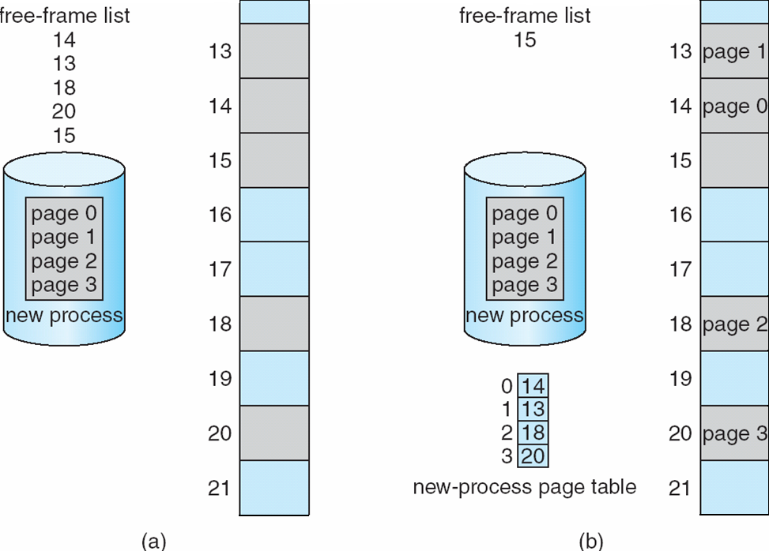
Free Frames
Before allocation
After allocation

Slide 43
Implementation of Page Table
Page table is kept in main memory
Page-table base register (PTBR) points to the page table
Page-table length register (PTLR) indicates size of the page table
In this scheme every data/instruction access requires two memory accesses
One for the page table and one for the data / instruction
The two-memory access problem can be solved using a special fast-lookup hardware cache called associative memory or translation look-aside buffers (TLBs)
A key
Value
Some TLBs store address-space identifiers (ASIDs) in each TLB entry – uniquely identifies each process to provide address-space protection for that process
Otherwise need to flush at every context switch

Slide 44
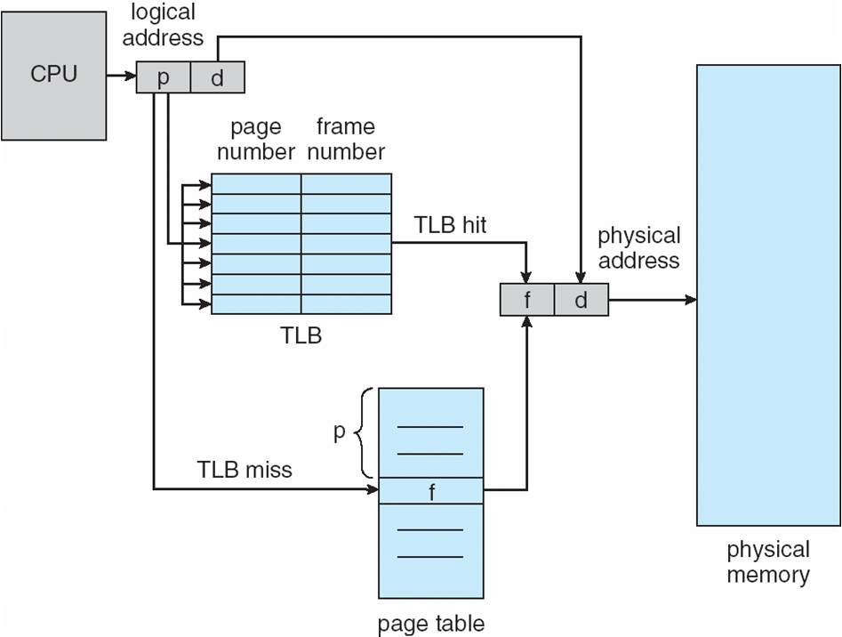
Associative Memory
On a TLB miss, value is loaded into the TLB for faster access next time
Associative memory – parallel search
Address translation (p, d)
If p is in associative register, get frame # out
Otherwise get frame # from page table in memory
Page #
Frame #

Slide 45
Effective Access Time
Associative Lookup = ε time unit
Can be < 10% of memory access time
Hit ratio = α
Hit ratio – percentage of times that a page number is found in the associative registers; ratio related to number of associative registers
Consider ε = 20ns for TLB search, 100ns for memory access
1 TLB hit = 20 + 100ns, 1TLB miss = 120 +100 ns
Effective Access Time (EAT)
Consider α = 80%
EAT= 0.80 x 120 + 0.20 x 220 = 140ns
Consider more realistic hit ratio -> α = 98%
EAT = 0.98 x 120 + 0.02 x 220 = 122ns

Slide 46
Memory Protection
Memory protection implemented by associating protection bit with each frame to indicate if read-only or read-write access is allowed
Can also add more bits to indicate page execute-only, and so on
Valid-invalid bit attached to each entry in the page table:
“valid” indicates that the associated page is in the process logical address space, and is thus a legal page
“invalid” indicates that the page is not in the process logical address space
Page-table length register (PTLR) indicate the size of page table
Any violations result in a trap to the kernel

Slide 47
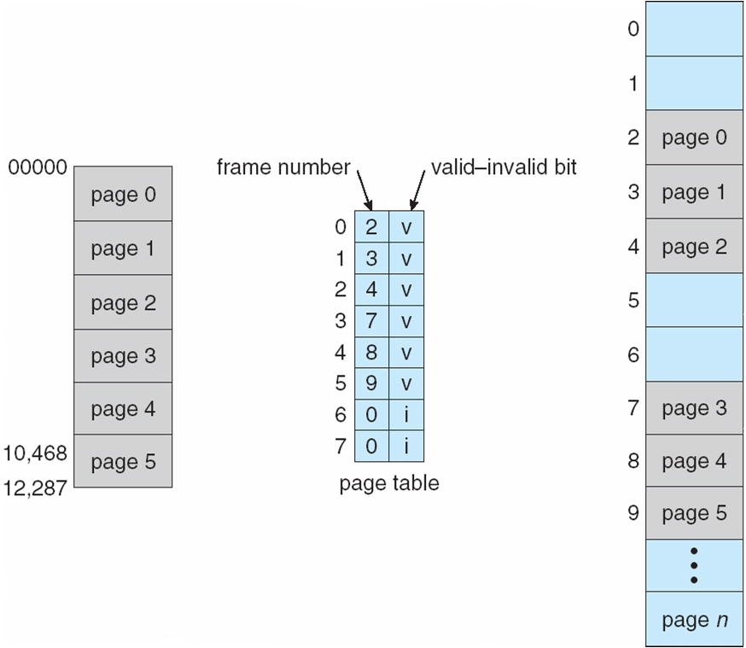
Valid (v) or Invalid (i) Bit In A Page Table

Slide 48
Shared Pages
An advantage of paging is the possibility of sharing common code.
Shared code
One copy of read-only (reentrant) code shared among processes (i.e., text editors, compilers, window systems)
Similar to multiple threads sharing the same process space
Also useful for interprocess communication if sharing of read-write pages is allowed
Private code and data
Each process keeps a separate copy of the code and data
The pages for the private code and data can appear anywhere in the logical address space

Slide 49
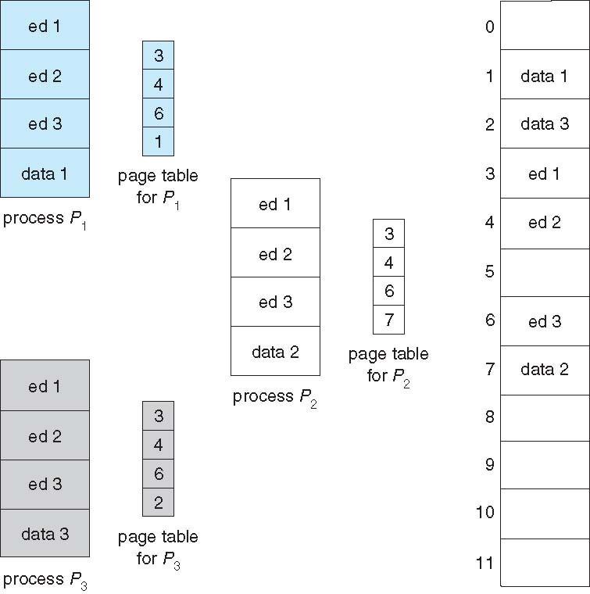
Shared Pages Example

Slide 50
Structure of the Page Table
Memory structures for paging can get huge using straight-forward methods
Consider a 32-bit logical address space as on modern computers
Page size of 4 KB (2¹²)
Page table would have 1 million entries (2³² / 2¹²)
If each entry is 4 bytes
Upto 4 MB of physical address space / memory for page table alone is required
That amount of memory used to cost a lot
Don’t want to allocate the page table contiguously in main memory
Solution: Divide the page table into smaller pieces.
There are several ways to accomplish this division:
Hierarchical Paging
Hashed Page Tables
Inverted Page Tables

Slide 51
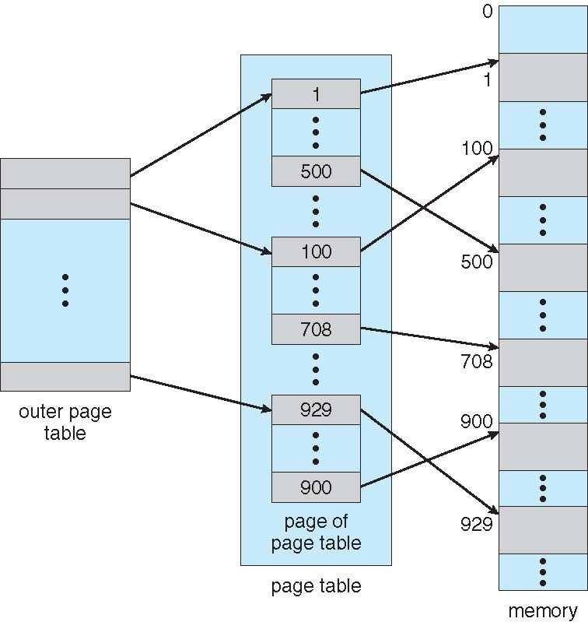
Hierarchical Page Tables
Break up the logical address space into multiple page tables
A simple technique is a two-level page table
We then page the page table
Figure 9.12 A two-level page-table scheme

Slide 52
Two-Level Paging Example (PII)
A logical address (on 32-bit machine with 1K page size) is divided into:
A page number consisting of 22 bits
A page offset consisting of 10 bits
Since the page table is paged, the page number is further divided into:
A 12-bit page number
A 10-bit page offset
Thus, a logical address is as follows:
where p₁ is an index into the outer page table, and p₂ is the displacement within the page of the inner page table
Known as forward-mapped page table
Pentium-II uses this architecture
page number
page offset
p₁
p₂
d
12
10
10

Slide 53
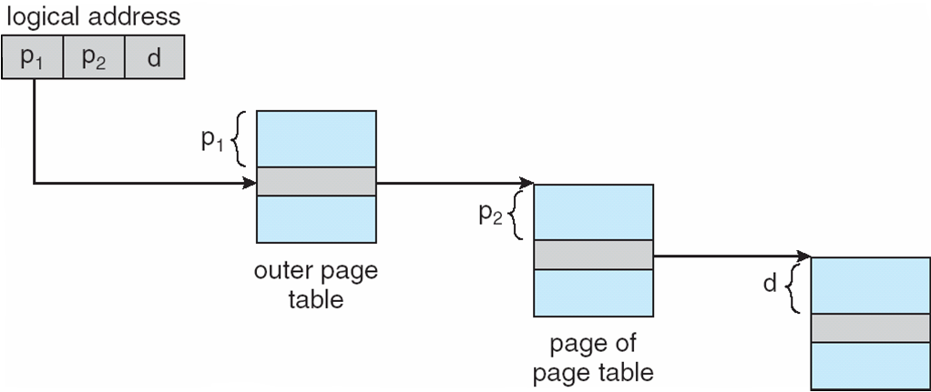
Address-Translation Scheme
Figure 9.13 Address translation for two-level 32 bit paging architecture

Slide 54
64-bit Logical Address Space
Even two-level paging scheme not sufficient
If page size is 4 KB (2¹²)
Then page table has 2⁵² entries
If two level scheme, inner page tables could be 2¹⁰ 4-byte entries
Address would look like
Outer page table has 2⁴² entries
One solution is to add a 2nd outer page table
But in the following example the 2nd outer page table is still 2³² bytes in size
And possibly 4 memory access to get to one physical memory location
outer page
inner page
page offset
p₁
p₂
d
42
10
12

Slide 55
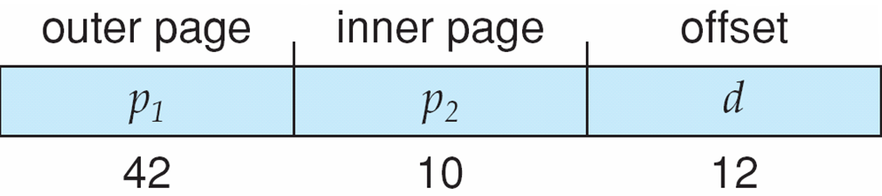
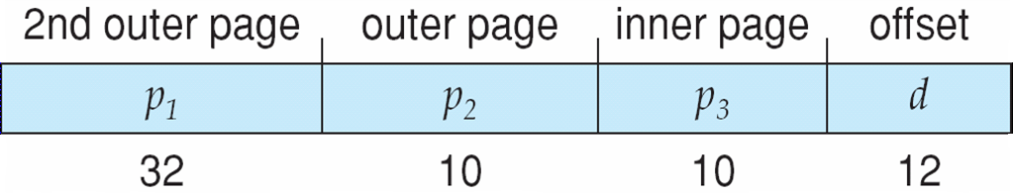
Three-level Paging Scheme
For the same processing, 64-bit architecture may require 7 levels of paging

Slide 56
Hashed Page Tables
Common in address spaces > 32 bits
The virtual page number is hashed into a page table
This page table contains a chain of elements hashing to the same location
Each element contains:
The virtual page number
The value of the mapped page frame
A pointer to the next element
Virtual page numbers are compared in this chain searching for a match
If a match is found, the corresponding physical frame is extracted

Slide 57
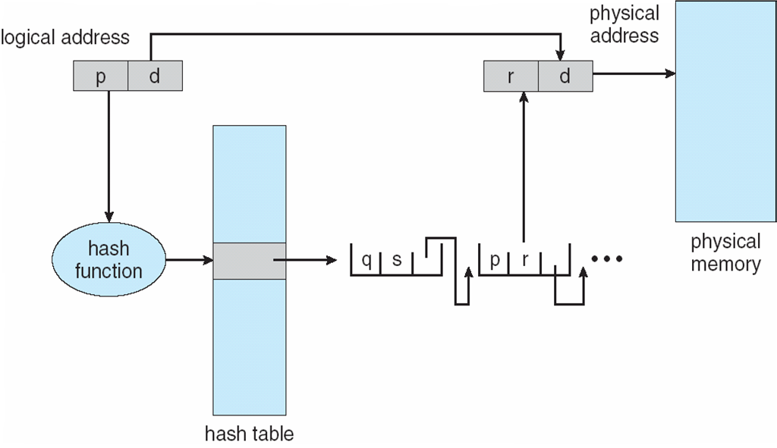
Hashed Page Table
Figure 9.14 Hashed page table

Slide 58
Inverted Page Table
Usually one process has an associated page table.
Rather than each process having a page table and keeping track of all possible logical pages, track all physical pages
One entry for each real page of memory
Entry consists of the virtual address of the page stored in that real memory location, with information about the process that owns that page
Decreases memory needed to store each page table, but increases time needed to search the table when a page reference occurs
Use hash table to limit the search to one — or at most a few — page-table entries
TLB can accelerate access

Slide 59
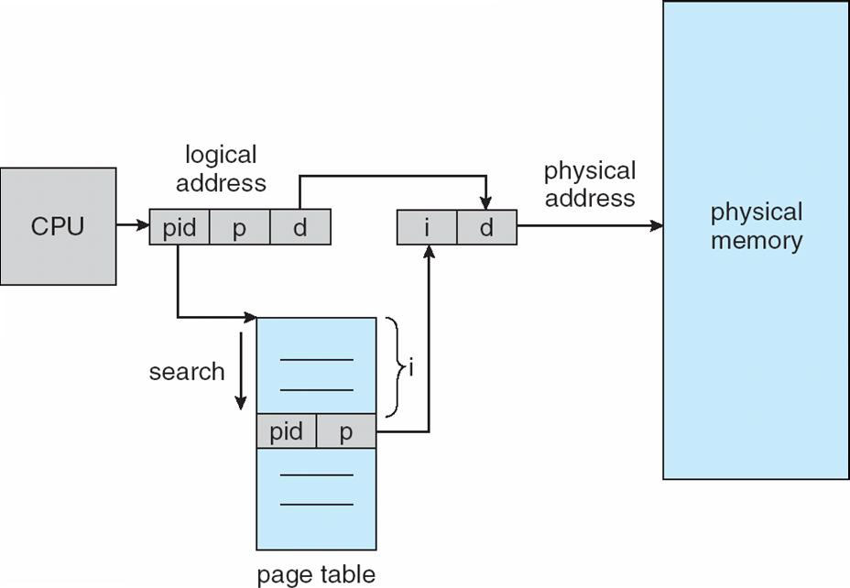
Inverted Page Table Architecture
Figure 9.15 Inverted page table

